Slide 1
Section 2.2 Geometric Sequences
i) Terms, common ratio, number of terms in a geometric sequence
ii) Geometric means
iii) Solving Algebraic sequences
© Copyright all rights reserved to Homework depot: www.BCMath.ca

Slide 2
I) What is a Geometric Sequence?
A sequence where each term after the first is multiplied by a common ratio “r”
Not the same as an arithmetic sequence (Add)
© Copyright all rights reserved to Homework depot: www.BCMath.ca

Slide 3
II) Formula for Geometric Sequence:
The value of the “n^{th}” term
Value of the 1st term
Common Ratio
- Divide any term by its previous term
The rank of the term
© Copyright all rights reserved to Homework depot: www.BCMath.ca

Slide 4
Ex: Given the following sequence, find the 20th term:
Ex: given the three terms in a geometric sequence, find the common ratio:
To find the common ratio, you can just take any term and divide it by the previous term
So, the common ratio will be:
© Copyright all rights reserved to Homework depot: www.BCMath.ca

Slide 5
Ex: the third term of a geometric sequence is 27 and the sixth term is 64. Find the common ratio:
Each term in the sequence is equal to the previous term multiplied by the common ratio:
The sixth term is equal to both 64 and 27r³
To find the terms in between, just multiply 27 by the common ratio.
Ex: Given and find the common ratio and the first term:
Now solve for
the first term
© Copyright all rights reserved to Homework depot: www.BCMath.ca

Slide 6
Ex: If
forms a geometric sequence.
Solve for x.
The new sequence formed is 1 , 2 , 4 which is a geometric sequence.
Ex: The first and second terms of a geometric sequence have a sum of 15, while the second and third terms have a sum of 60. Use an algebraic method to find all three terms.

Slide 7
III) Terms & FINAL equation:
Double Time: The time it takes a population or the weight of an object to double its size or value
Half – Life: The time it takes a population or object to depreciate to half its size or value
Ie: Time it takes a
population to double
Ie: Time required to
reach Half - Life
Annually: L = 1
© Copyright all rights reserved to Homework depot: www.BCMath.ca

Slide 8
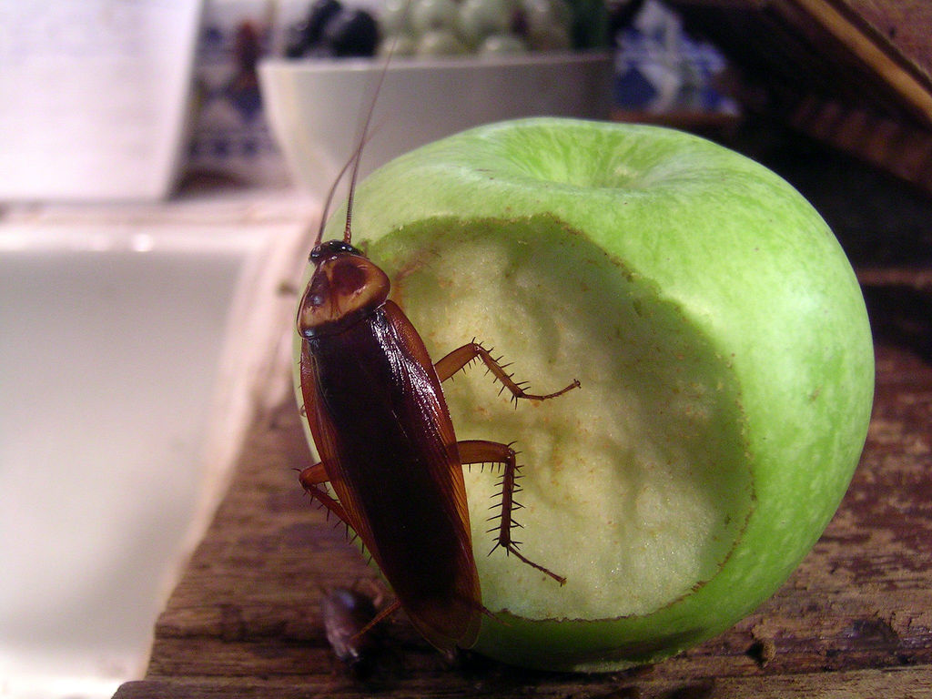
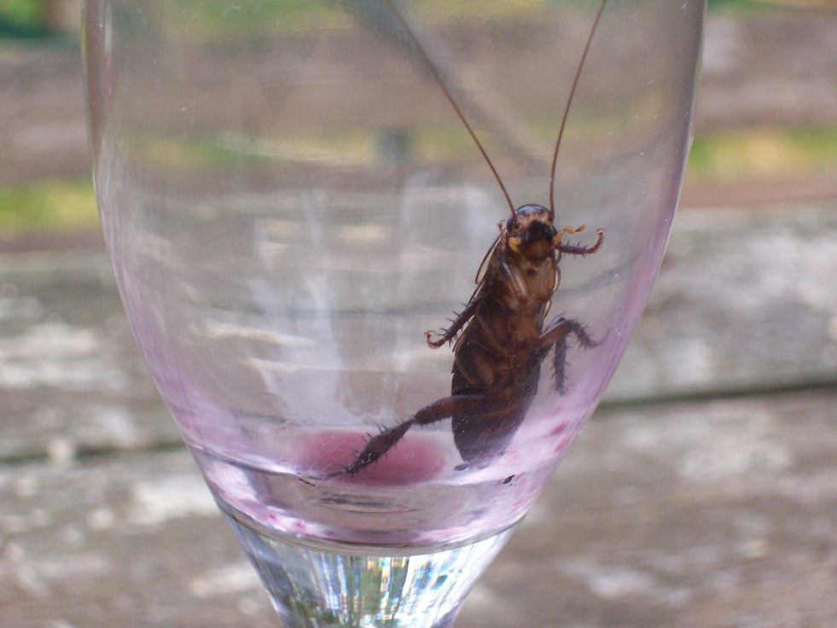
Ex: Cockroach Question:
If a colony of 2 cockroaches doubles every day, how many cockroaches will there be after 1 week?
© Copyright all rights reserved to Homework depot: www.BCMath.ca

Slide 10
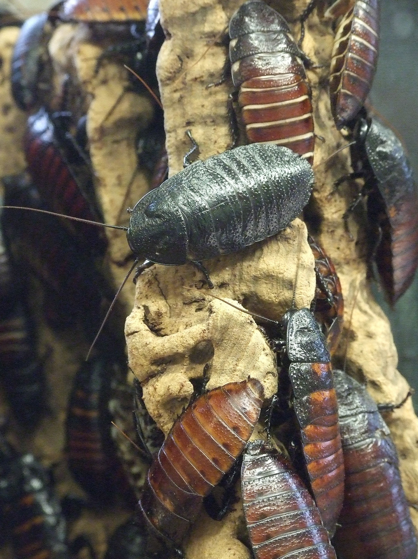
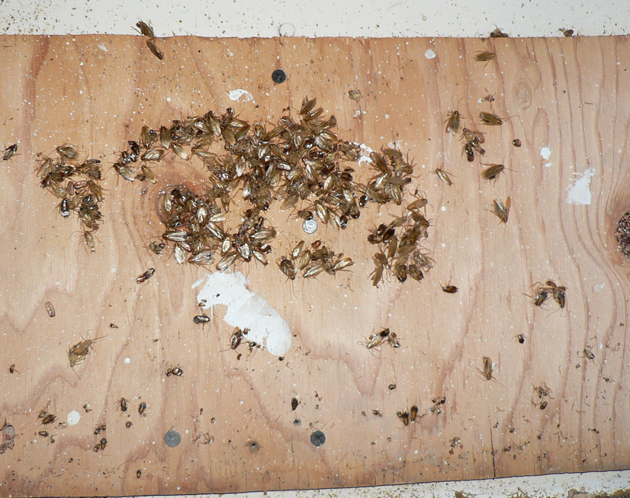
© Copyright all rights reserved to Homework depot: www.BCMath.ca

Slide 11
© Copyright all rights reserved to Homework depot: www.BCMath.ca

Slide 12
Ex: If a colony of 12 cockroaches doubles every 3 days, after how many days will the population be over 10,000?
After 30 days, the population of the cockroaches will be over 10,000!!
© Copyright all rights reserved to Homework depot: www.BCMath.ca

Slide 13
Ex: The first and second terms of a geometric sequence have a sum of 15, while the second and third terms have a sum of 60. Use an algebraic method to find all three terms.
Let the first three terms be
We will find r from the following system of two equations in two unknowns.
Dividing equation (2) by equation (1)
we can eliminate a.

